Slide 1

Defining Variable Types
Chris Piech
CS106A, Stanford University

Slide 2
Can you do this?

Slide 3
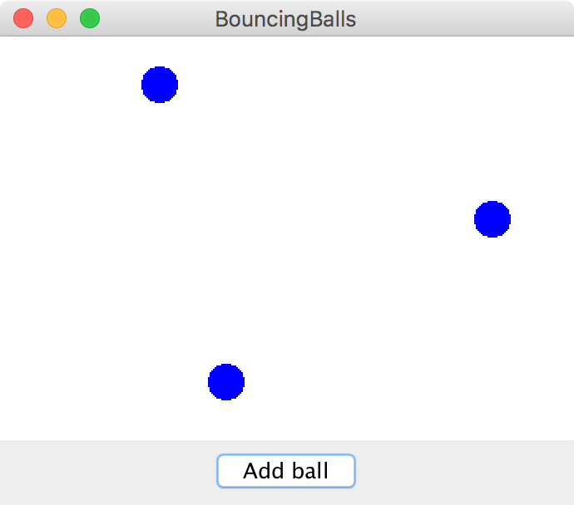
Bouncing Balls

Slide 4
Interactors

Slide 5
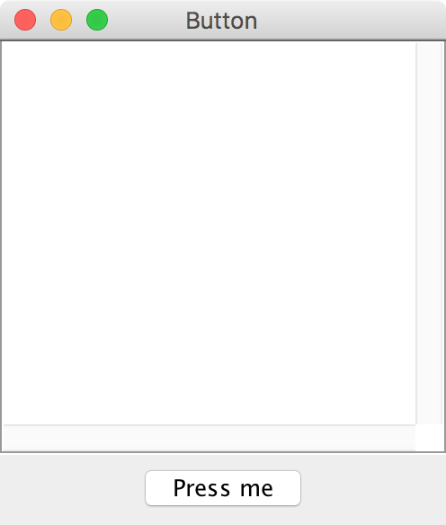
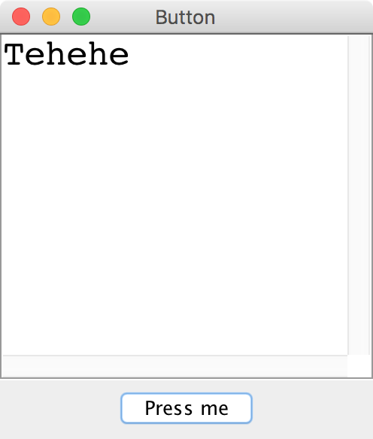
Button

Slide 6
Some large programs are in Java

Slide 9
How?

Slide 10

Define New Variable Types
Email Sender
Login Manager
Inbox Database
Email
Inbox
User

Slide 11
Even small programs
define new variable types

Slide 12
You Have Been Using Variable Types
GOval
String
“Hello, world”
RandomGenerator
What would it take to define your own?

Slide 13
What Does GRect Look Like?
GRect.java
public class GRect {
// Instance variables
private double width = 0;
private double height = 0;
private double yc = 0;
private double xc = 0;
private boolean isFilled = false;
private boolean isVisible = false;
// Constructors
public GRect(double width, double height) {
this.width = width;
this.height = height;
}
public GRect(double x, double y, double width, double height) {
this.xc = x;
this.yc = y;
this.width = width;
this.height = height;
}
...

Slide 14


Classes define new Variable Types
A student registration system needs to store info about students, but Java has no Student type.
A music synthesizer app might want to store information about different voices, but Java has no Guitar type.
However, Java does provide a feature for us to add new data types to the language: classes.
Writing a class defines a new data type.
“This class is so meta” – Anonymous Stanford Student

Slide 15

Classes are like blueprints
class: A template for a new type of variable.
Blueprint for student
A blueprint is a helpful analogy
Instance of student
Instance of student
Instance of student

Slide 16
Classes define new variable types

Slide 17
Classes decompose your program across files

Slide 18
Classes are like blueprints
To design a new variable type you must specify three things:
What subvariables make up this new variable type?
What behaviors does this new variable type support?
What happens when you make a new instance of this type?

Slide 19
What is a class?

Slide 20
A class defines a new variable type

Slide 21
Kenya has used mobile banking for > 15 years

Slide 22
Classes: Take 1
This goes in BankAccount.java!
public class BankAccount {
// the instance variable define what makes up the class
public String name;
public double money;
}
Instance variables have a special meaning

Slide 23
Classes: Take 1
public class BankAccount {
// the instance variable define what makes up the class
public String name;
public double money;
}
BankAccount.java
public class Benmo{
public void run() {
BankAccount chris = new BankAccount();
BankAccount mehran = new BankAccount();
chris.name = “Chris”;
chris.money = 100;
mehran.name = “Mehran”;
mehran.money = 999999;
}
}
Benmo.java

Slide 24
Classes: Take 1
public class BankAccount {
// the instance variable define what makes up the class
public String name;
public double money;
}
BankAccount.java
public class Benmo{
public void run() {
BankAccount chris = new BankAccount();
BankAccount mehran = new BankAccount();
chris.name = “Chris”;
chris.money = 100;
mehran.name = “Mehran”;
mehran.money = 999999;
}
}
Benmo.java
run
name
chris
money
mehran

Slide 25
Classes: Take 1
public class BankAccount {
// the instance variable define what makes up the class
public String name;
public double money;
}
BankAccount.java
public class Benmo{
public void run() {
BankAccount chris = new BankAccount();
BankAccount mehran = new BankAccount();
chris.name = “Chris”;
chris.money = 100;
mehran.name = "Mehran";
mehran.money = 999999;
}
}
Benmo.java
run
name
chris
money
name
mehran
money

Slide 26
Classes: Take 1
public class BankAccount {
// the instance variable define what makes up the class
public String name;
public double money;
}
BankAccount.java
public class Benmo{
public void run() {
BankAccount chris = new BankAccount();
BankAccount mehran = new BankAccount();
chris.name = “Chris”;
chris.money = 100;
mehran.name = "Mehran";
mehran.money = 999999;
}
}
Benmo.java
run
name
“Chris”
chris
money
name
mehran
money

Slide 27
Classes: Take 1
public class BankAccount {
// the instance variable define what makes up the class
public String name;
public double money;
}
BankAccount.java
public class Benmo{
public void run() {
BankAccount chris = new BankAccount();
BankAccount mehran = new BankAccount();
chris.name = “Chris”;
chris.money = 100;
mehran.name = "Mehran";
mehran.money = 999999;
}
}
Benmo.java
run
name
“Chris”
chris
money
100.0
name
mehran
money

Slide 28
Classes: Take 1
public class BankAccount {
// the instance variable define what makes up the class
public String name;
public double money;
}
BankAccount.java
public class Benmo{
public void run() {
BankAccount chris = new BankAccount();
BankAccount mehran = new BankAccount();
chris.name = “Chris”;
chris.money = 100;
mehran.name = "Mehran";
mehran.money = 999999;
}
}
Benmo.java
run
name
“Chris”
chris
money
100.0
name
"Mehran"
mehran
money

Slide 29
Classes: Take 1
public class BankAccount {
// the instance variable define what makes up the class
public String name;
public double money;
}
BankAccount.java
public class Benmo{
public void run() {
BankAccount chris = new BankAccount();
BankAccount mehran = new BankAccount();
chris.name = “Chris”;
chris.money = 100;
mehran.name = "Mehran";
mehran.money = 999999;
}
}
Benmo.java
run
name
“Chris”
chris
money
100.0
name
"Mehran"
mehran
money
999999.0

Slide 31
What is a class?

Slide 32
A class defines a new variable type

Slide 33
Adding Privacy
private double money;
encapsulation: Hiding implementation details of an object from its clients.
Encapsulation provides abstraction.
separates external view (behavior) from internal view (state)
Encapsulation protects the integrity of an object's data.
It means that the class is more reusable.
A class's instance variables should be declared private.
No code outside the class can access or change it.

Slide 34
withdraw
Bank account data
run
deposit
Wall of abstraction

Slide 35
How do we get this?
Benmo.java
public class Benmo{
public void run() {
...
chris.deposit(1000);
}
}
run
name
“Chris”
chris
money
100.0
name
"Mehran"
mehran
money
999999.0

Slide 36
Classes: Take 2
This goes in its own file!
public class BankAccount {
// the instance variable define what makes up the class
public String name;
public double money;
}
Instance variables have a special meaning

Slide 37
Classes: Take 2
public class BankAccount {
// 1. What variables make up the class
public String name;
public double money;
}

Slide 38
Classes: Take 2
public class BankAccount {
// 1. What variables make up the class
private String name;
private double money;
}

Slide 39
Classes: Take 2
public class BankAccount {
// 1. What variables make up the class
private String name;
private double money;
// 2. What methods can a user call on a bankAccount?
public void deposit(double amount) {
...
}
public boolean withdraw(double amount) {
...
}
}
BankAccount.java
Benmo.java
public class Benmo{
public void run() {
...
chris.deposit(1000);
}
}

Slide 40
Classes: Take 2
public class BankAccount {
// 1. What variables make up the class
private String name;
private double money;
// 2. What methods can a user call on a bankAccount?
public void deposit(double amount) {
this.money += amount;
}
public boolean withdraw(double amount) {
...
}
}
In the example, this is chris
public class Benmo{
public void run() {
...
chris.deposit(1000);
}
}

Slide 41
Classes: Take 2
public class BankAccount {
// 1. What variables make up the class
private String name;
private double money;
// 2. What methods can a user call on a bankAccount?
public void deposit(double amount) {
money += amount;
}
public boolean withdraw(double amount) {
...
}
}
BankAccount.java
Benmo.java
public class Benmo{
public void run() {
...
chris.deposit(1000);
}
}

Slide 42
this

Slide 43
When you call a class method, you must call it on an instance of that class. There is a special keyword this which refers to that instance.
this
chris.deposit(1000);

Slide 44
When you call a class method, you must call it on an instance of that class. There is a special keyword this which refers to that instance.
this
chris.deposit(1000);

Slide 45
When you call a class method, you must call it on an instance of that class. There is a special keyword this which refers to that instance.
this
chris.deposit(1000);

Slide 46
When you call a class method, you must call it on an instance of that class. There is a special keyword this which refers to that instance.
this
chris.deposit(1000);
This is the instance I am calling deposit on

Slide 47
When you call a class method, you must call it on an instance of that class. There is a special keyword this which refers to that instance.
this
myOval.getX();
This is the GOval I am calling getX on

Slide 48
Classes: Take 2
public class BankAccount {
// 1. What variables make up the class
private String name;
private double money;
// 2. What methods can a user call on a bankAccount?
public void deposit(double amount) {
this.money += amount;
}
public boolean withdraw(double amount) {
...
}
}
BankAccount.java
Benmo.java
public class Benmo{
public void run() {
...
chris.deposit(1000);
}
}

Slide 49
Classes: Take 2
public class BankAccount {
// 1. What variables make up the class
private String name;
private double money;
// 2. What methods can a user call on a bankAccount?
public void deposit(double amount) {
this.money += amount;
}
public boolean withdraw(double amount) {
...
}
}
BankAccount.java
Benmo.java
public class Benmo{
public void run() {
...
boolean success = chris.withdraw(1000);
}
}

Slide 50
Classes: Take 2
public class BankAccount {
// 1. What variables make up the class
private String name;
private double money;
// 2. What methods can a user call on a bankAccount?
public void deposit(double amount) {
this.money += amount;
}
public boolean withdraw(double amount) {
if(amount <= this.money) {
this.money -= amount;
return true;
}
return false;
}
}
BankAccount.java

Slide 51
Classes: Take 2
public class BankAccount {
// 1. What variables make up the class
private String name;
private double money;
// 2. What methods can a user call on a bankAccount?
public void deposit(double amount) {
this.money += amount;
}
public boolean withdraw(double amount) {
if(amount <= this.money) {
this.money -= amount;
return true;
}
return false;
}
// 3. How do you make a new one?
public BankAccount(String name, double amount) {
this.name = name;
this.money = amount;
}
}
BankAccount.java

Slide 53
You must define three things
1. What variables does each instance store?
2. What methods can you call on an instance?
3. What happens when you make a new one?

Slide 54
Classes on one slide
1. What variables make up this new super variable type?
Instance variables
2. What methods can you call on a variable of this type?
It’s public methods
3. What happens when the user makes a new instance?
The “constructor”
* Don’t forget that all methods and constructors have access to a this reference

Slide 55
What is a class?

Slide 56
A class defines a new variable type

Slide 57
Bouncing Balls

Slide 58
A Ball Variable Type
The Ball class
1. What variables does each instance store?
Each ball has its own Goval (lets call it shape)
Each ball has its own dx
Each ball has its own dy
2. What methods can you call on an instance?
heartbeat();
getGOval();
3. What happens when you make a new one?
Sets initial values for all the ”instance” vars
*details on how to define these three things coming soon

Slide 59
What classes?

